Slide 1
Majoritarian Threats in a Pluralistic Society: Recent Alarming Developments in the Philippines
Prof. H. Harry L. Roque, Jr
UP College of Law
Philippine Judicial Academy

Slide 2
Philippine Constitutional Framework
Philippines Bill Of Rights:
Section 5. No law shall be made respecting an establishment of religion, or prohibiting the free exercise thereof. The free exercise and enjoyment of religious profession and worship, without discrimination or preference, shall forever be allowed. No religious test shall be required for the exercise of civil or political rights.

Slide 3
History of Constitutional Framework:
More than 300 years of Spanish Colonial Rile characterized by unity of Church and State
Catholicism was the official religion of Spain. This policy was exported to the Philippines
Spanish penal law: six acts were defined as “Crimes Against Religion and Worship”. Two of these continue to be felonies under the existing revised penal code.

Slide 4
American Period
An immediate thrust hence of the American when they came in the early 1900’s was to repeal this system of unity between the church and state.
The language of the Treaty of Paris itself made the session of the Philippine archipelago “secured in the free exercise of religion”.
President Mc Kinley’s instruction ordered the “complete separation of church and state, and the abolition of all special privileges and all restrictions therefore conferred or imposed upon any particular religious sect”.

Slide 5
US v. Balcorta: The Philippine Bill of 1902 “caused the complete separation of church and state, and the abolition of all special privileges and all restrictions there from conferred or imposed upon any particular religious sect”

Slide 6
US v. Smith, the Court also ruled that the classification of church authorities as “persons in authority” in the Spanish penal code had ceased to be of any effect.

Slide 7
Thesis
While Constitution provides for the non-establishment clause, this has been construed by Philippine Courts as applying largely to minority religions and not to the majoritarian faith: the catholic faith. It is alarming that recently, the majoritarian view has been increasingly intolerant of minority beliefs, including those who criticize the catholic faith

Slide 8
Examples of pro-catholic rulings
Commemorative Stamp marking the 33rd International Eucharistic Congress of the Catholic Church
Aglipay v. Ruiz: Court found no violation of the non-establishment clause because the religious significance was allegedly, merely “secondary to the main purpose of the commemorative stamp “

Slide 9
Aglipay v. Ruiz
“It is obvious that while the issuance and sale of the stamps in question may be said to be inseparably linked with an event of a religious character, the resulting propaganda, if any received by the Roman Catholic Church, was not the main purpose of the government. We are of the opinion that Government should not be embarrassed in its activities simply because of the incidental results, more or less religious in character, if the purposes had in view is one which could legitimately be undertaken by appropriate legislation. The main purpose should not be frustrated by its subordination to mere incidental results not contemplated”

Slide 10
Garces v. Estenzo
“Not every governmental activity which involves the expenditure of public funds and which has some religious tint is violative of the constitutional provisions regarding separation of church and state, freedom of worship and banning the use of public money or property.”

Slide 11
“The wooden image was purchased in connection with the celebration of the barrio fiesta honoring the patron saint, San Vicente Ferrer, and not for the purpose of favoring any religion nor interfering with religious matters or the religious beliefs of the barrio residents. One of the highlights of the fiesta was the mass. Consequently, the image of the patron saint had to be placed in the church when the mass was celebrated. If there is nothing unconstitutional or illegal in holding a fiesta and having a patron saint for the barrio, then any activity intended to facilitate the worship of the patron saint (such as the acquisition and display of his image) cannot be branded as illegal.”

Slide 12
Is a religious attack made by a minority religion v. catholic church subject to censorship?

Slide 13
INK v. CA
Yes
We reject petitioners submission which need not set us adrift in a constitutional voyage towards an uncharted sea
The right to religious profession and worship has a two-fold aspect, viz., freedom to believe and freedom to act on ones beliefs. The first is absolute as long as the belief is confined within the realm of thought. The second is subject to regulation where the belief is translated into external acts that affect the public welfare.

Slide 14
Saving Grace: Clear and Present danger test
In fine, respondent board cannot squelch the speech of petitioner Iglesia ni Cristo simply because it attacks other religions, even if said religion happens to be the most numerous church in our country. In a State where there ought to be no difference between the appearance and the reality of freedom of religion, the remedy against bad theology is better theology. The bedrock of freedom of religion is freedom of thought and it is best served by encouraging the marketplace of dueling ideas. When the luxury of time permits, the marketplace of ideas demands that speech should be met by more speech for it is the spark of opposite speech, the heat of colliding ideas that can fan the embers of truth

Slide 15
Soriano v. CA
Clear and Present Danger Test abandoned.
Attacking a religious rival may be classified as “obscenity”

Slide 16
Alarm Bells:
1. RH Bill- Philippines is only country together with Vatican with no divorce law.
Now one of the few former colonies without an RH law. Catholic countries that have passed RH laws: Argentina, Colombia, Ecuador, Guatemala, and Mexico, Italy, Poland, Paraguay, Portugal, and Spain.
UN Population Fund, profiled 48 Catholic countries, only six countries did not have a reproductive health law. The Philippines is one of them.

Slide 17
People Support RH Bill
Social Weather Stations reported that 71 percent were in favor of the RH bill.
Pulse Asia reported that 69 percent were in favor of the RH bill.

Slide 18
Church position v. RH Bill: "We are at a crossroads as a nation x x x This proposed bill in all its versions calls us to make a moral choice: to choose life or to choose death."

Slide 19
1968 encyclical Humanae Vitae issued by Pope Paul 6.
condemns artificial contraception, based on the following arguments:
• The constant and perennial teaching of the Church.
• The natural law that certain acts and the generative processes are in some way especially inviolable, precisely because they are generative. Contraception is evil, because it changes an act which is naturally oriented to procreation, into an act which is oriented to the mutual benefit of the spouses.

Slide 20
preachers telling parishioners that support for the RH Bill ipso facto is a serious sin and merits excommunication.
Muntinlupa Barangay Ordinance which prohibits sale of contraceptives

Slide 21
Legal Issue on RH Bill
Fr Bernas: freedom of religion means more than just the freedom to believe. It also means the freedom to act or not to act according to what one believes. Hence, the state should not prevent people from practicing responsible parenthood according to their religious belief nor may churchmen compel President Aquino, by whatever means, to prevent people from acting according to their religious belief.
Those responsible for government are required to interpret the common good of their country not only according to the guidelines of the majority but also according to the effective good of all the members of the community, including the minority.”

Slide 22
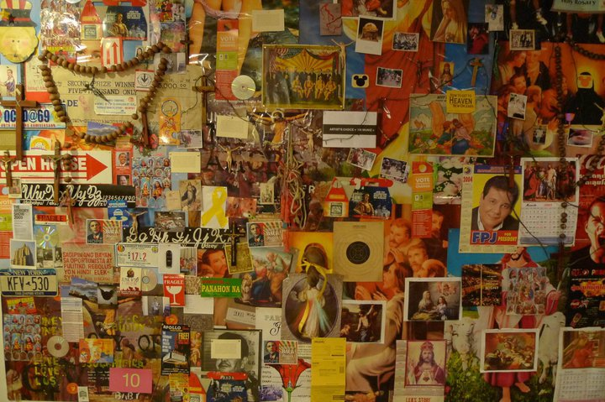
No. 2 Art and Blaspemy: Kulo

Slide 23
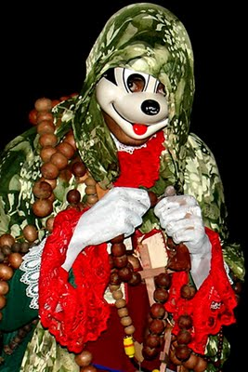

Slide 24
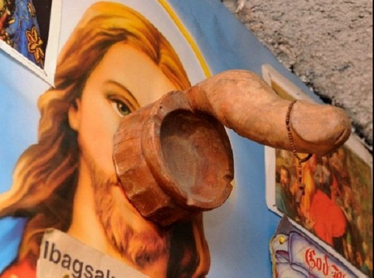

Slide 25
Church Position
“the exercise of artistic freedom for the sake of art is subject to moral criteria.”
Cruz’s work is “offensive,” “desecrating” and “blasphemous”
“the picture of Jesus is not just any picture; it’s the picture of God, someone we adore, someone we glorify.“…please, nothing like that should be repeated again because of the religious sentiments.”

Slide 26
Criminal Case filed against artist and CCP by members of a Catholic religious party
Charge:Violation of ART. 201, RPC
Art. 201. Immoral doctrines, obscene publications and exhibitions and indecent shows. — The penalty of prision mayor or a fine ranging from six thousand to twelve thousand pesos, or both such imprisonment and fine, shall be imposed upon x x x; (2) (a) the authors of obscene literature, published with their knowledge in any form x x x (b) Those who, in theaters, fairs, cinematographs or any other place, exhibit, indecent or immoral plays, scenes, acts or shows, whether live or in film, which are prescribed by virtue hereof, shall include those which x x x(2) serve no other purpose but to satisfy the market for violence, lust or pornography; (3) offend any race or religion; x x x and (5) are contrary to law, public order, morals, and good customs, established policies, lawful orders, decrees and edicts; x x x

Slide 27
Defense
1. Not pornography: social commentary
“Poleteismo is an attempt to critique and lay bare the many idolatries that ironically animate so much of our culture’s search for perfection. It is a mirror projecting onto the viewer the contradictory ways in which we try to create and re-create both our self- understanding and our self-image.”

Slide 28
“harsh look at a particular form of religiosity that refuses to engage in self-critique but instead prefers the pomp and pageantry of empty religious rituals”.
Condoms generously strewn all over the installation represent the questions I raise against the hypocrisies I see in Philippine culture.
phalluses are symbolic representations of patriarchy, power and worship. Vatican City is itself an excellent repository of phallic symbols from the antiquities.

Slide 29
2. Jurisprudence precludes art work exhibited in galleries from being“pornographic”
3. Exhibit warned that it may be offensive to minors

Slide 30
Even if it were blasphemous
“If there is a bedrock principle underlying the First Amendment, it is that the government may not prohibit the expression of an idea simply because society finds the idea itself offensive or disagreeable”. (Texas vs. Johnson)

Slide 31
Burstyn v. Wilson
[F]rom the standpoint of freedom of speech and the press, it is enough to point out that the state has no legitimate interest in protecting any or all religions from views distasteful to them which is sufficient to justify prior restraints upon the expression of those views. It is not the business of government in our nation to suppress real or imagined attacks upon a particular religious doctrine, whether they appear in publications, speeches, or motion pictures.

Slide 32
INK v. CA
In a State where there ought to be no difference between the appearance and the reality of freedom of religion, the remedy against bad theology is better theology. The bedrock of freedom of religion is freedom of thought and it is best served by encouraging the marketplace of dueling ideas. When the luxury of time permits, the marketplace of ideas demands that speech should be met by more speech for it is the spark of opposite speech, the heat of colliding ideas that can fan the embers of truth

